Slide 1

Elemental Motion in Spatial Usage and Interaction
SCI 6365 | Final Project
Understanding space through motion experience and computer vision
Jessica Chen and Margaret Zhou

Slide 2
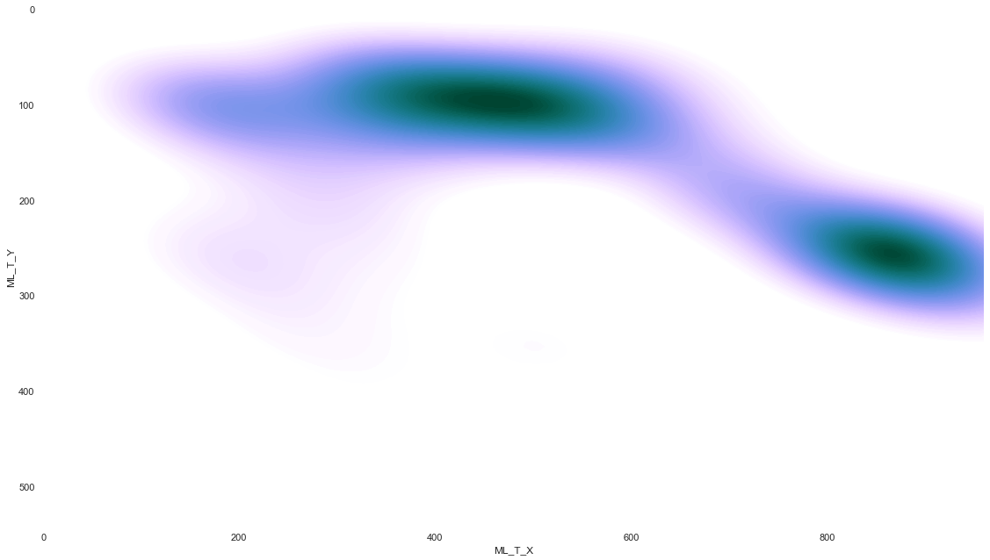
Abstract
This study explores the systematic, quantitative analysis of motion in a given architectural space. It attempts to taxonomize human body motion, presenting a framework that can be built upon and layered to represent a wider context of determinants.
Notes:
<30 seconds
Timestamp: 1:00

Slide 3
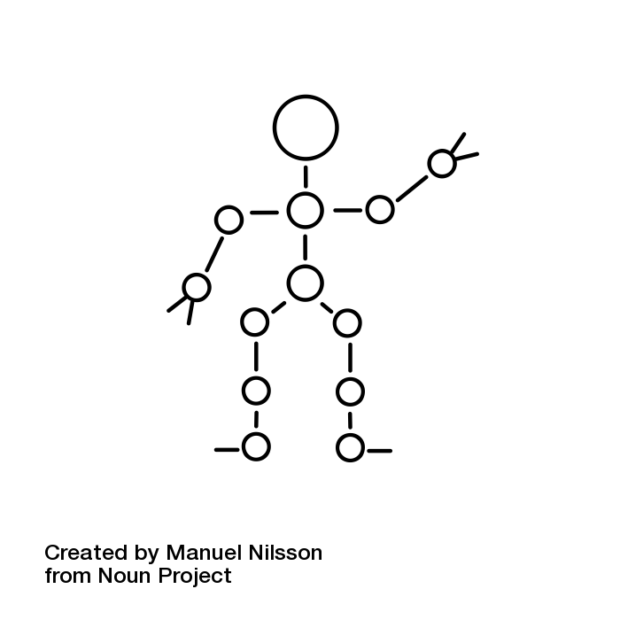



Method
Gather Data
Literature & Observation
Analyze
Reflect
Record activities in a certain space with a positioned Video Camera
Apply data structure learnings and use ML tools to attempt to detect movement types
Reflect on framework and make adjustments where necessary
Transcribe movements manually and categorize into logical structure

Slide 4
Elements of Spatial Motion
Notes:
1.5 minutes
Timestamp: 4:30

Slide 5
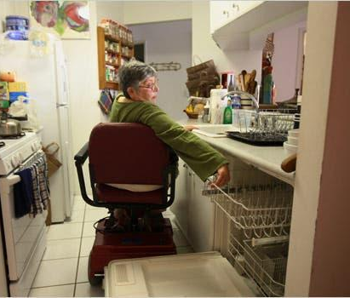
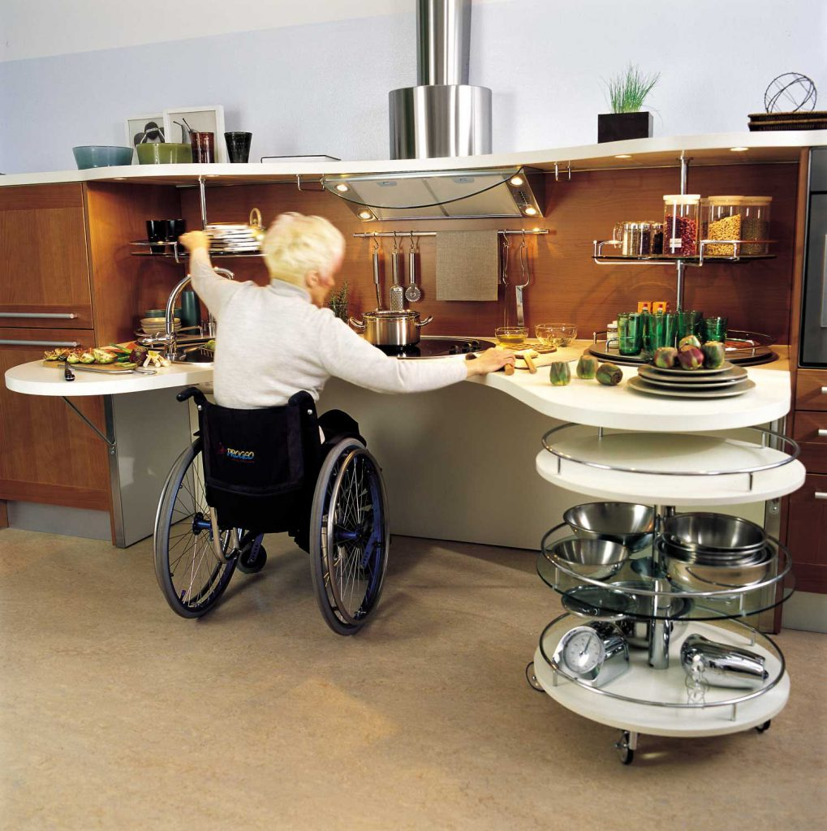

Case Study - Wheelchair Accessible Kitchens
Factors:
Difficulty
Traffic
Hazards
Occupation Time/Density
Navigation
Proxemics
Locomotor
Non-Locomotor
Horizontal
Rotation
Reaching
Bending
Gather Data
Choose Motions to Study
Implement code using Posenet
Analyze Data
Suggestions
Notes:
30 second
Timestamp: 5:00
In considering the usage of elemental motion in improving and understanding spatial layouts, there were a number of factors that were important to consider for a user. Of those, we chose to focus on movement difficulty within domestic settings, particularly in relation to adapting existing environments for wheelchair users. We chose to focus specifically on motion types Turning, Bending and Reaching due to the limits of wheelchair mobility. While we do not attempt to resolve the problems that arise, we use the study as a way to bring light to the potential use of motion analysis frameworks in universal architectural design.

Slide 6
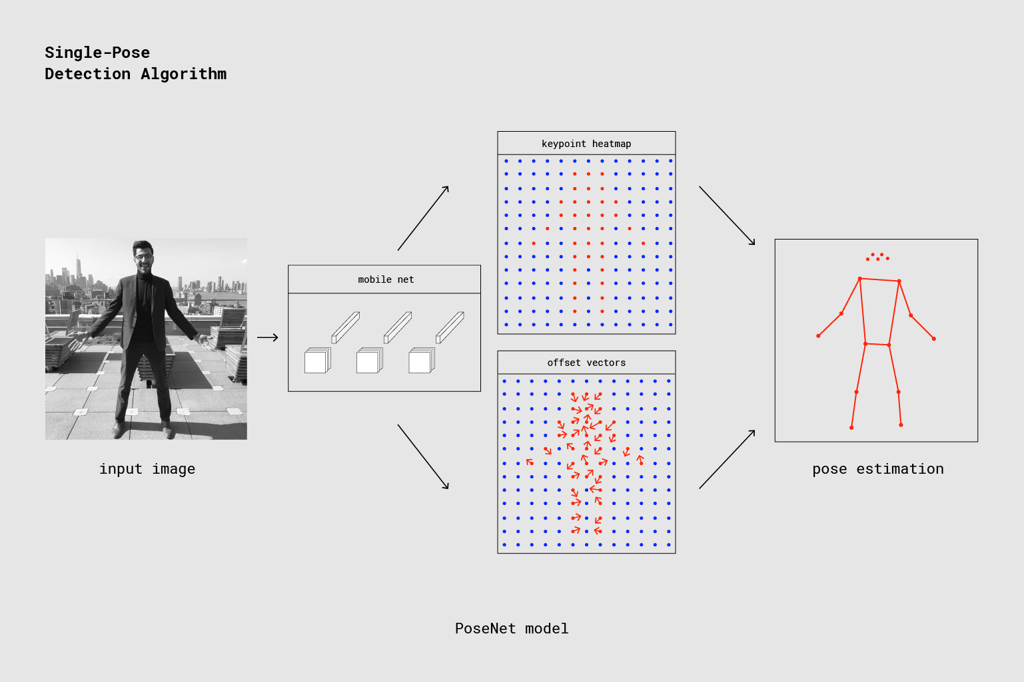
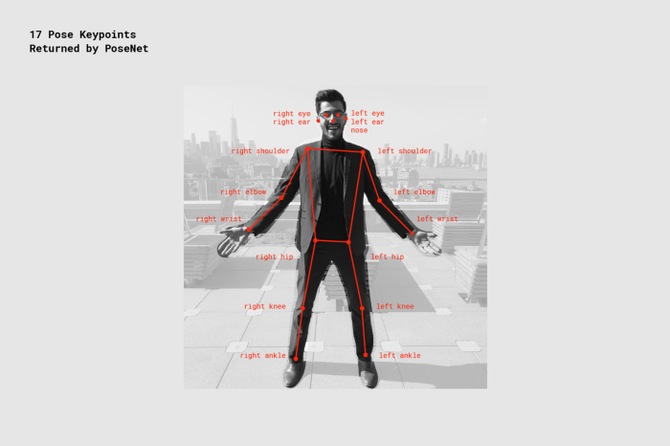
Machine Learning: PoseNet
Gather Data
Choose Motions to Study
Implement code using Posenet
Analyze Data
Suggestions

Slide 7
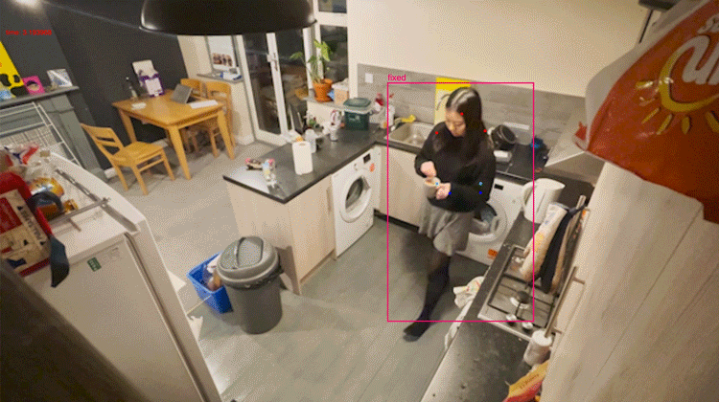
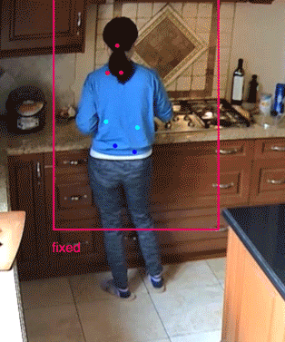
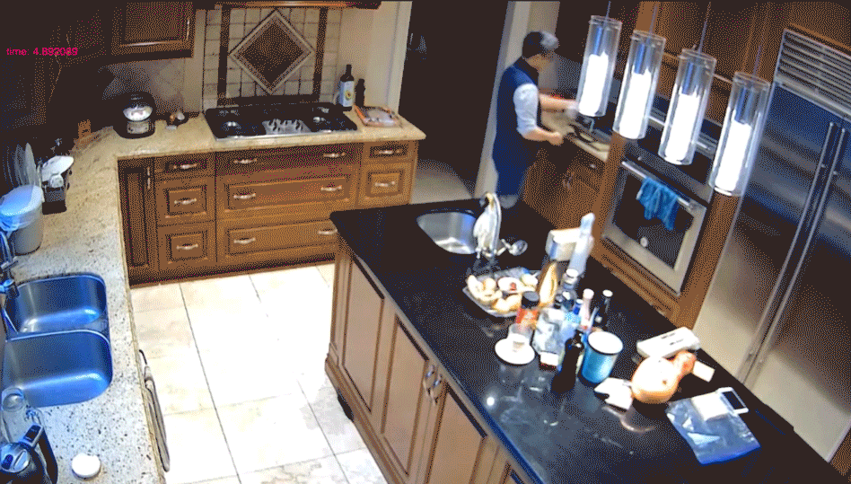
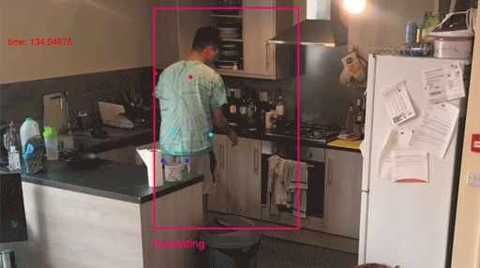
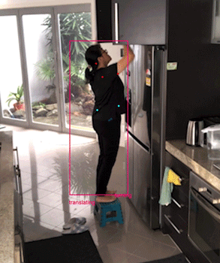
Identification
Locomotor
Locomotor
Non-Locomotor
Horizontal
Rotation
Upper Body
translating
fixed
turning
bending
reaching
Notes:
30 seconds
Timestamp: 6:30

Slide 8
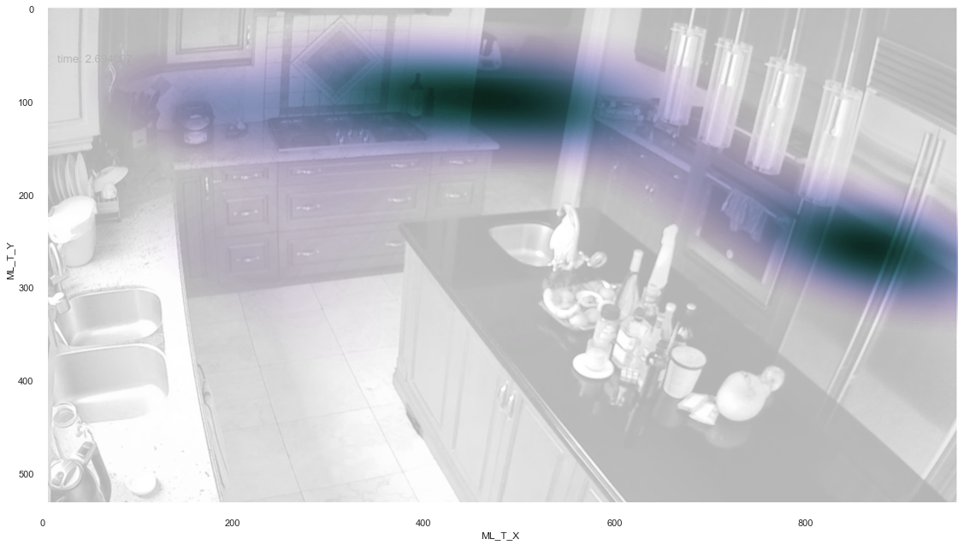
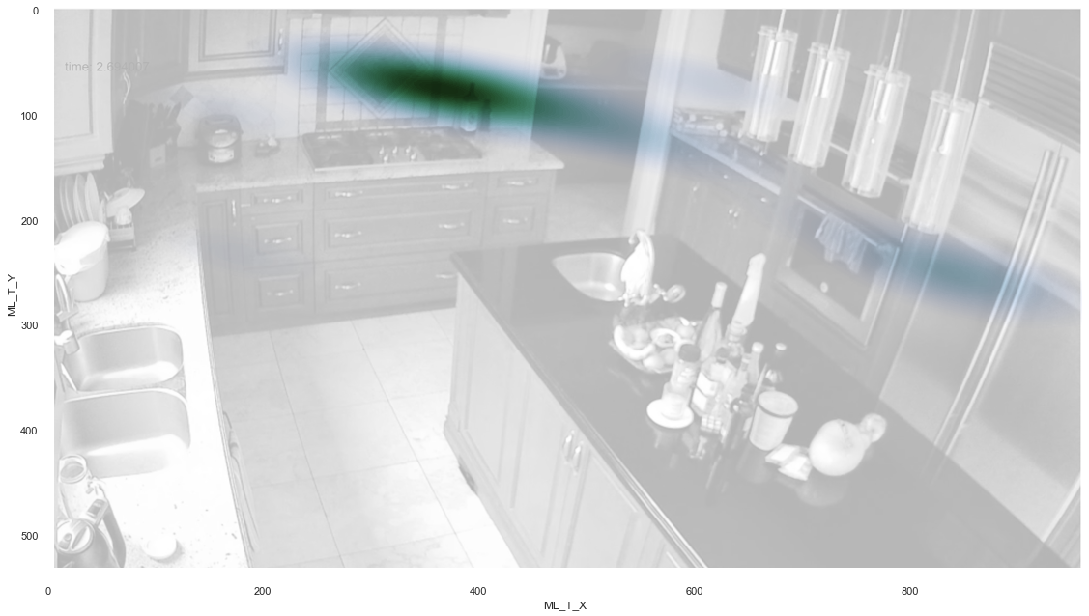
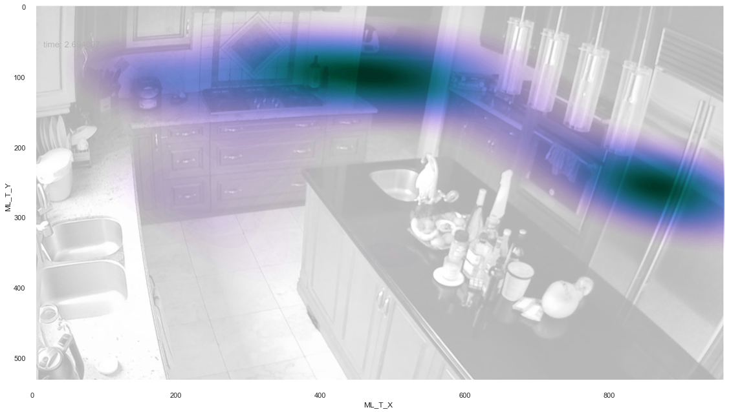

Analysis - Kitchen 1
Goal: Breakfast Preparation
Locomotor: Translation, Fixed
Horizontal Translation
Fixed in Position
Instances Detected: 1718
Instances Detected: 866

Slide 9
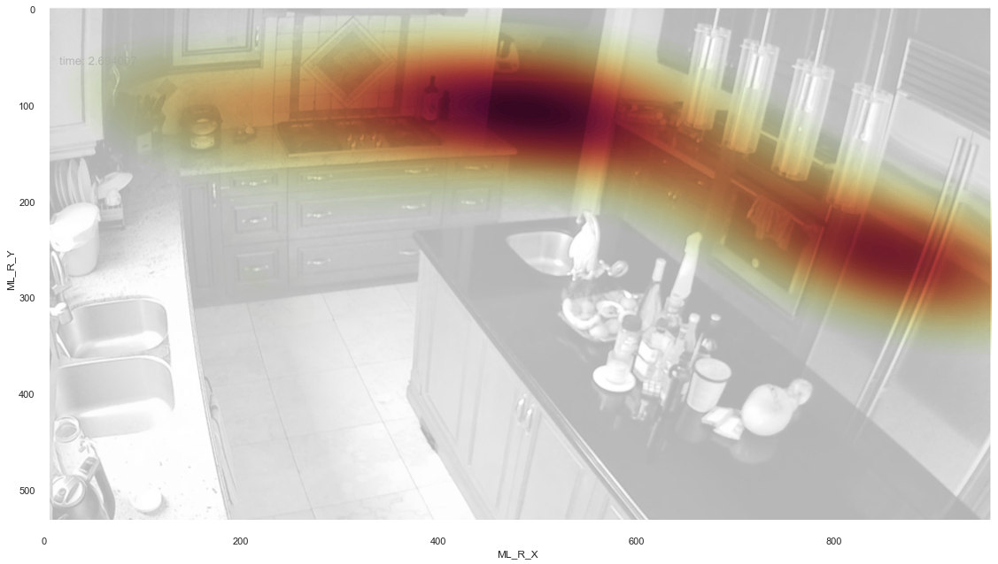
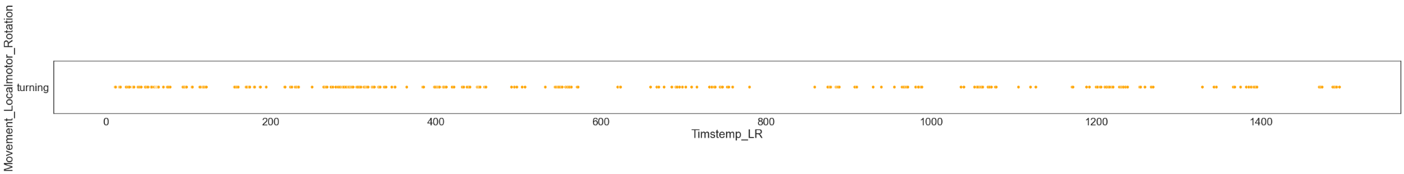
Analysis - Kitchen 1
Goal: Breakfast Preparation
Locomotor: Rotation
Rotation
Instances Detected: 301
Notes:
30 seconds
Timestamp: 7:30

Slide 10
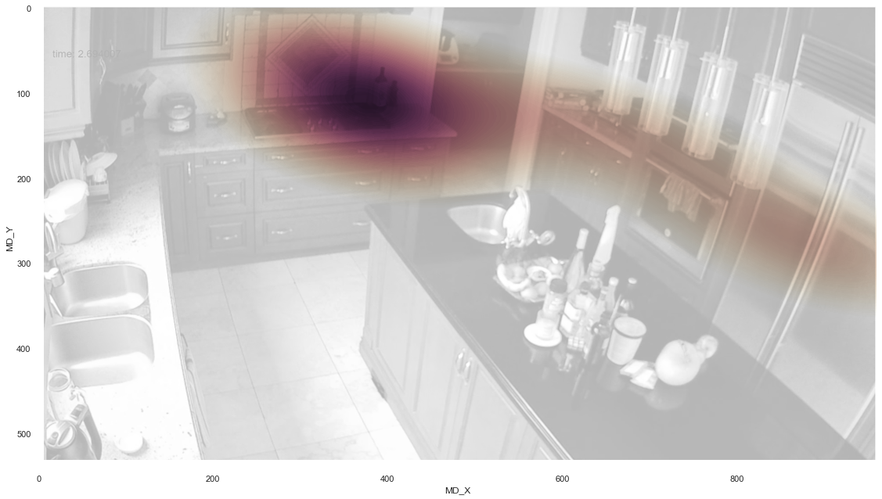
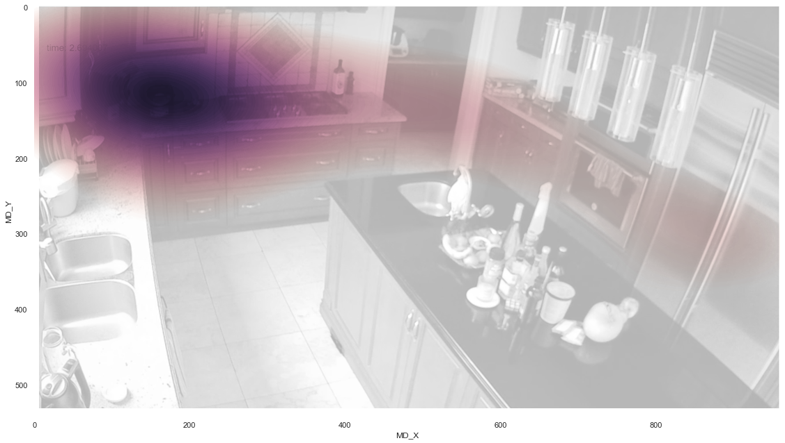
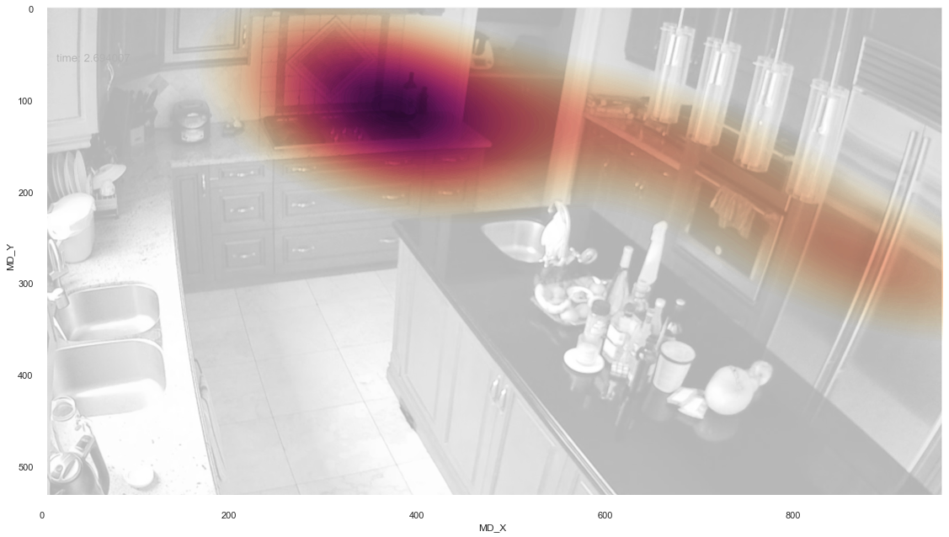

Analysis - Kitchen 1
Goal: Breakfast Preparation
Non-Locomotor: Bending, Reaching
Bending
Reaching
Instances Detected: 114
Instances Detected: 63
Notes:
30 seconds
Timestamp: 8:00

Slide 11
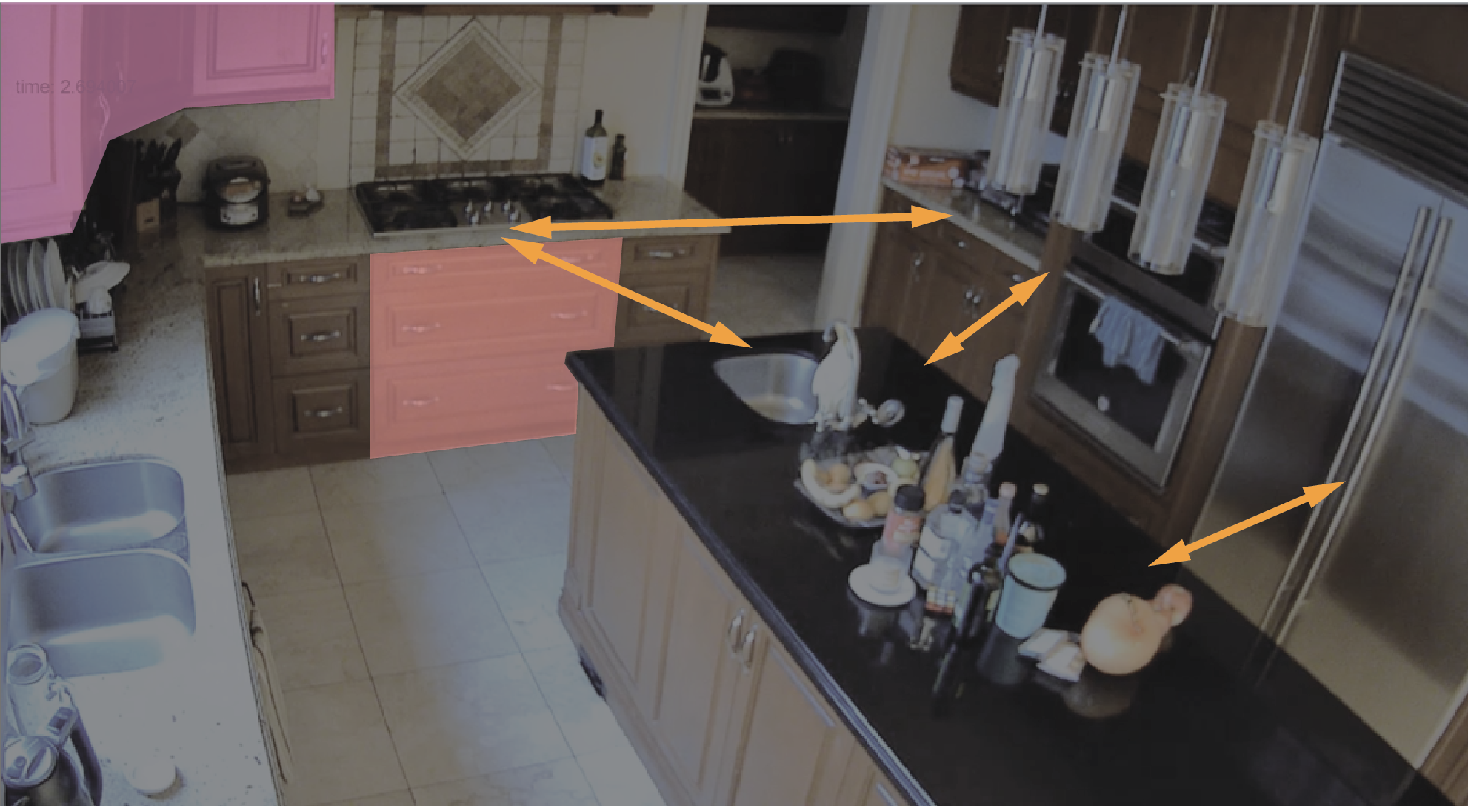
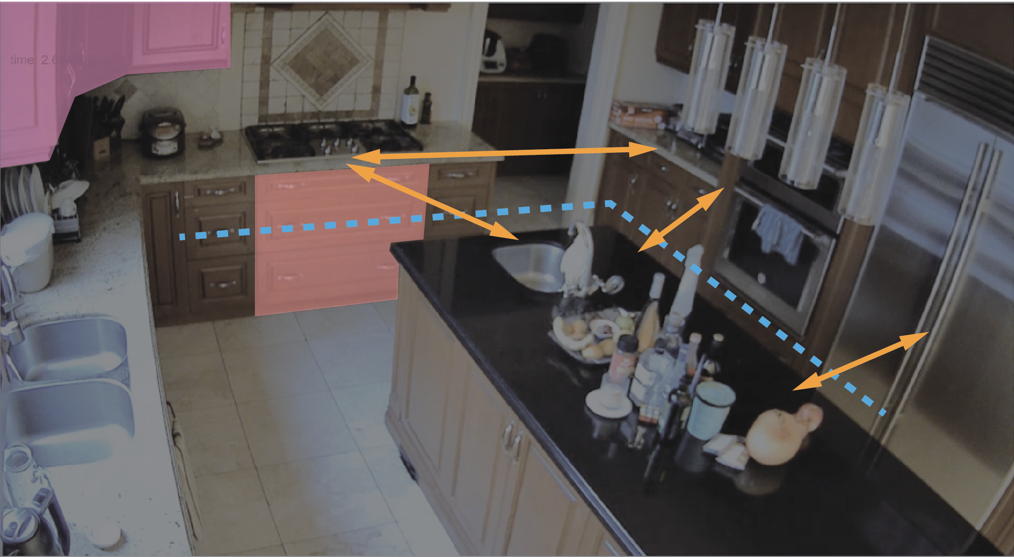
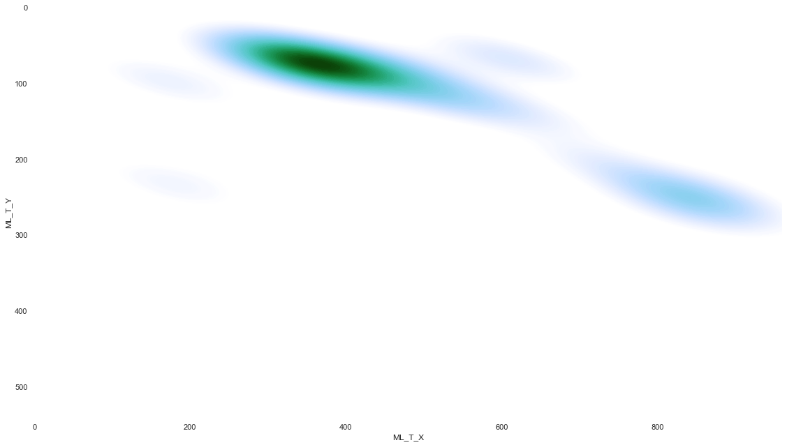
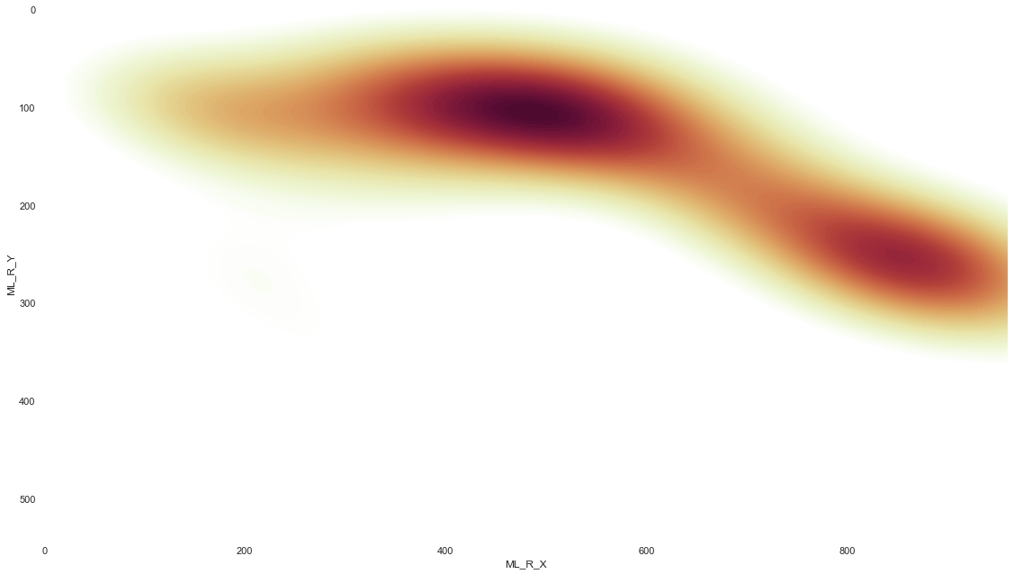
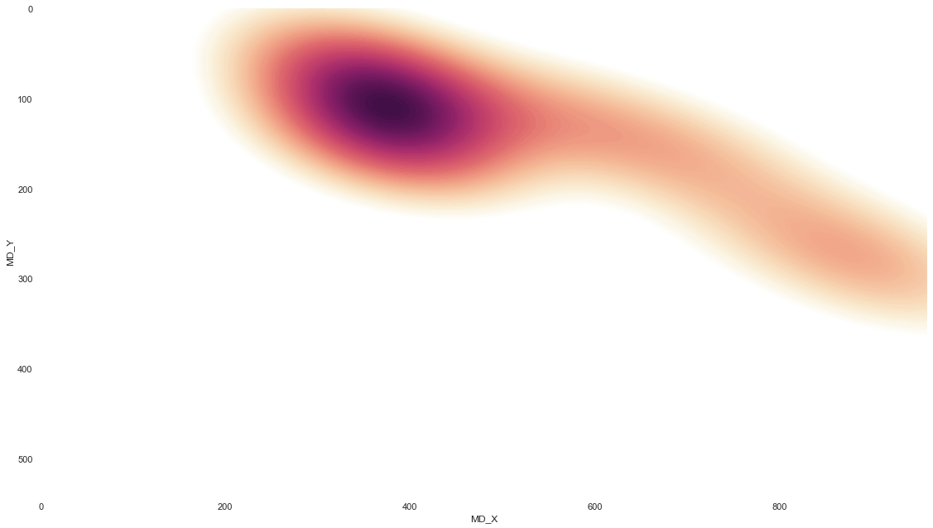
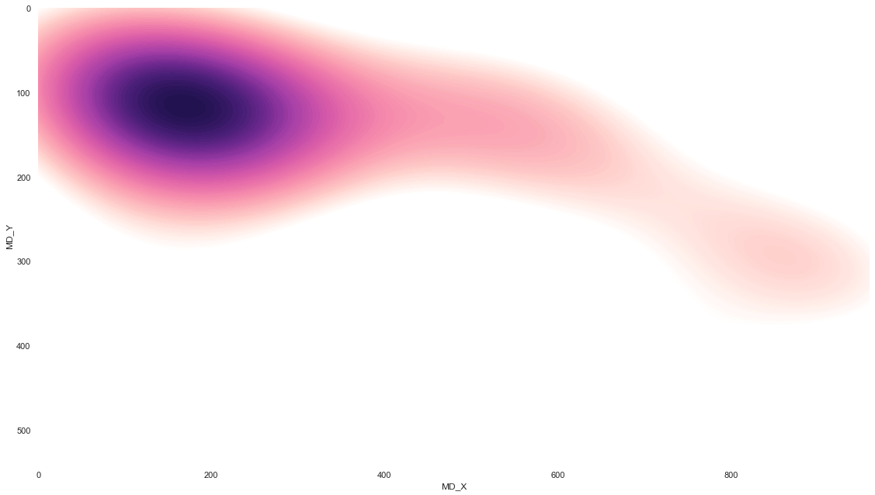
Analysis - Design Suggestions
Eliminate items stored at high location to avoid straining and improve accessibility
Do not place the items used often on the lowest drawers
The back to back design in the kitchen results lots of large angle turns, which may not be ideal for wheelchair users
Widen the paths that are used often
1.
2.
3.
4.
Notes:
30 seconds
Timestamp: 8:30

Slide 12
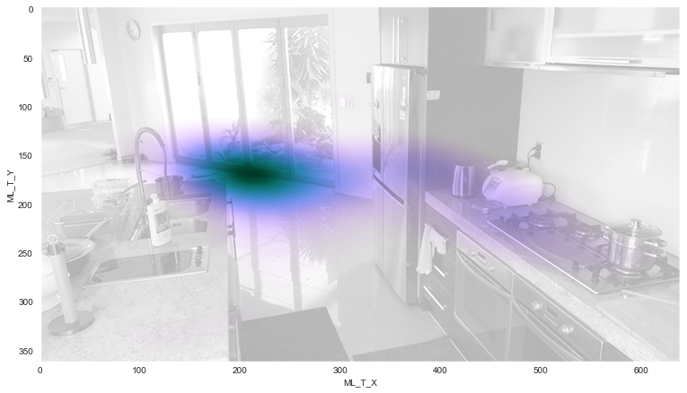
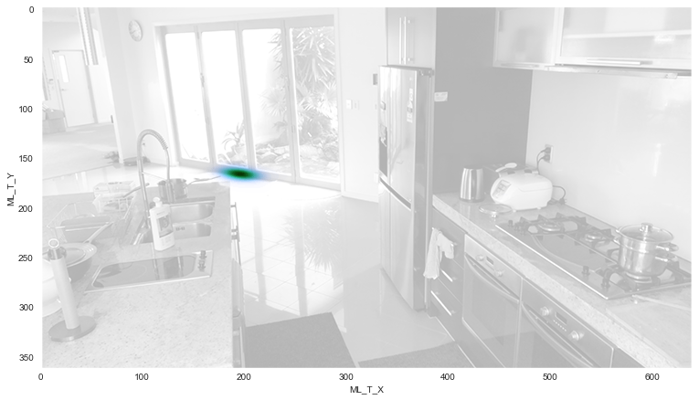
Analysis - Kitchen 2
Goal: Washing Dishes
Locomotor: Translation, Fixed
Horizontal Translation
Fixed in Position
Instances Detected: 1213
Instances Detected: 4940
Notes:
30 seconds
Timestamp: 9:00

Slide 13
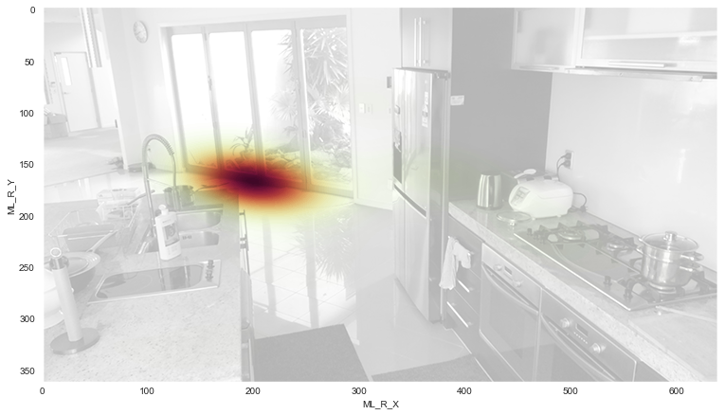
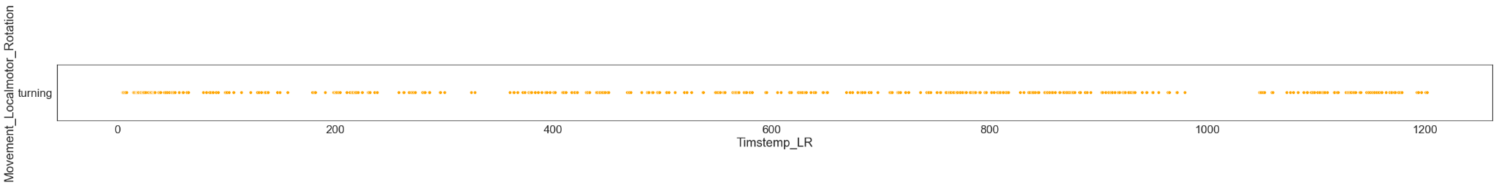
Analysis - Kitchen 2
Goal: Cooking, Washing Dishes
Locomotor: Rotation
Rotation
Instances Detected: 520
Notes:
30 seconds
Timestamp: 9:30

Slide 14
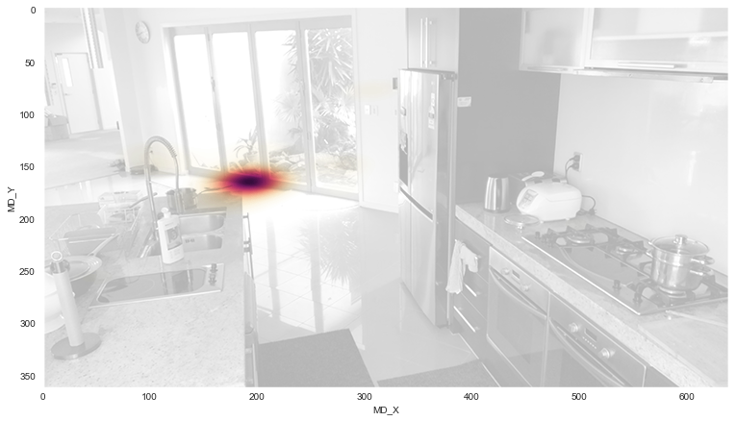
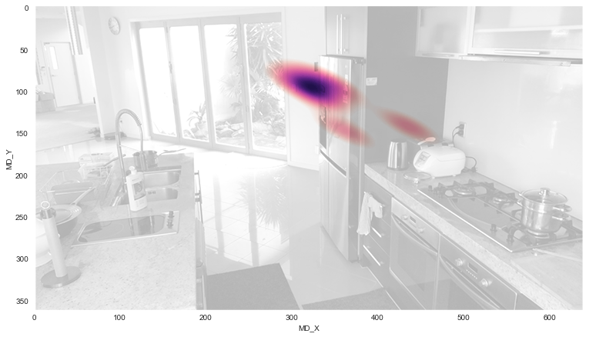
Analysis - Kitchen 2
Goal: Cooking, Washing Dishes
Non-Locomotor: Bending, Reaching
Bending
Reaching
Instances Detected: 417
Instances Detected: 28
Notes:
30 seconds
Timestamp: 10:00

Slide 15
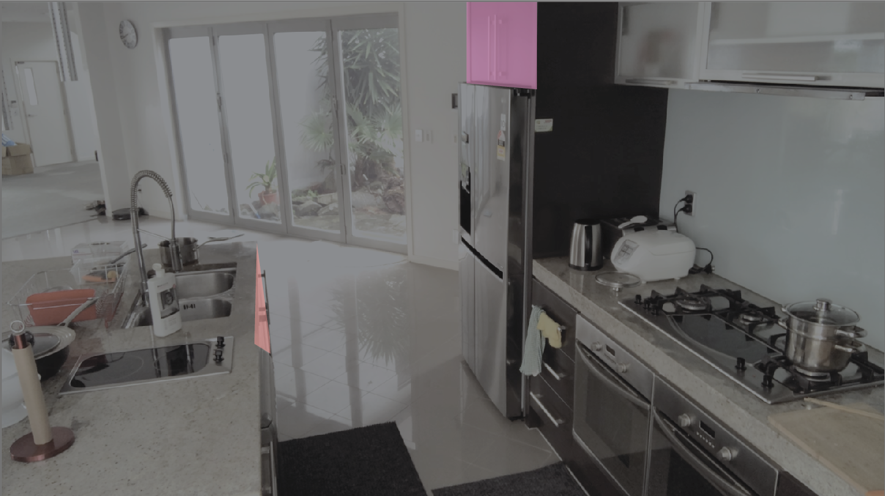
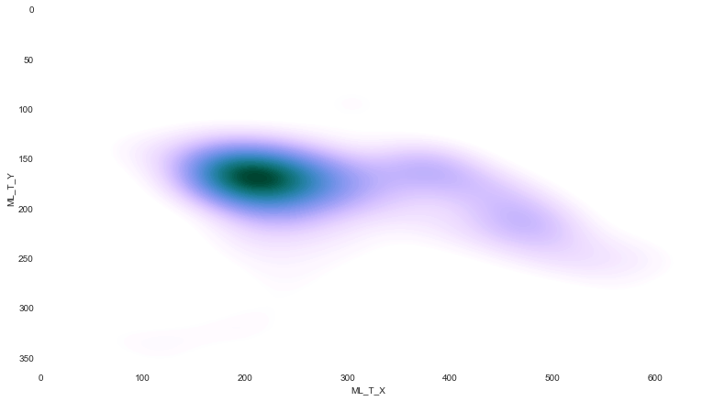
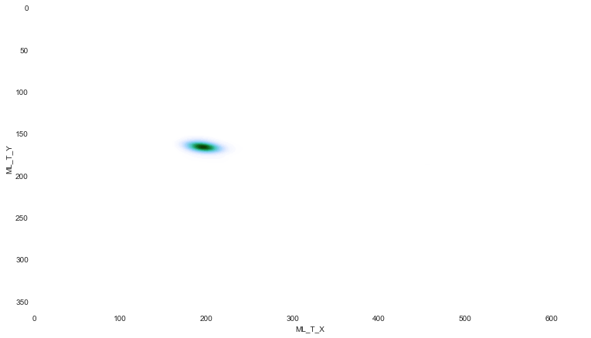
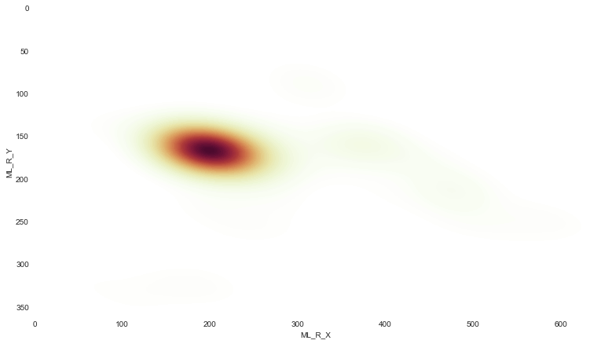
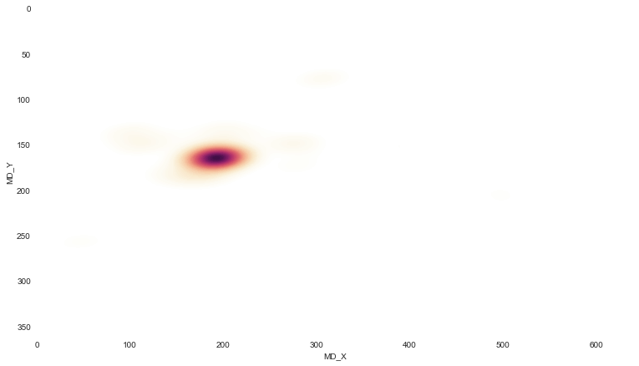
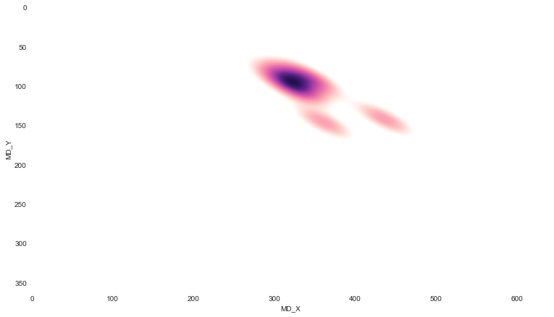
Analysis - Design Suggestions
Not to store items at high location to avoid straining and improve accessibility
Do not place the items used often on the lowest drawers
1.
2.
Notes:
30 seconds
Timestamp: 10:30

Slide 16
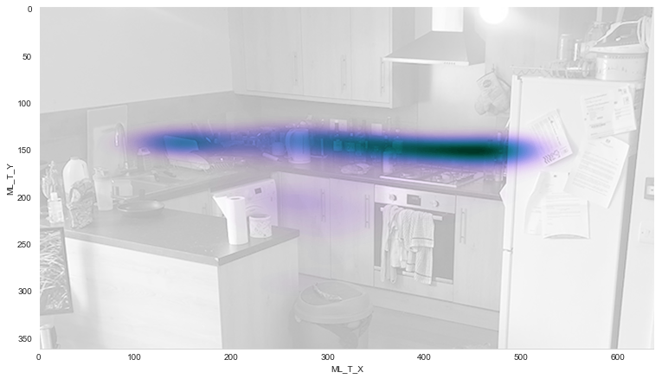
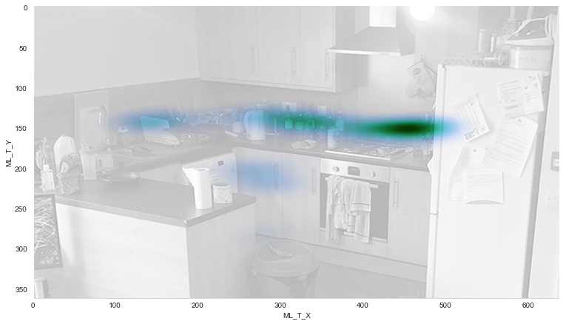
Analysis - Kitchen 3
Goal: Cooking
Locomotor: Translation, Fixed
Horizontal Translation
Fixed in Position
Instances Detected: 2333
Instances Detected: 3839

Slide 17
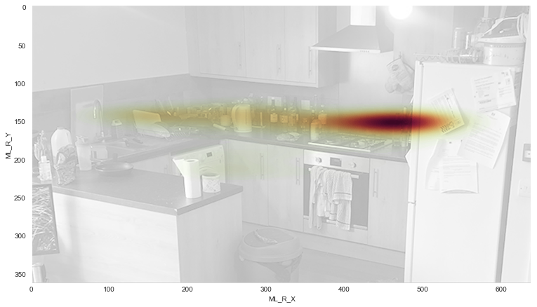
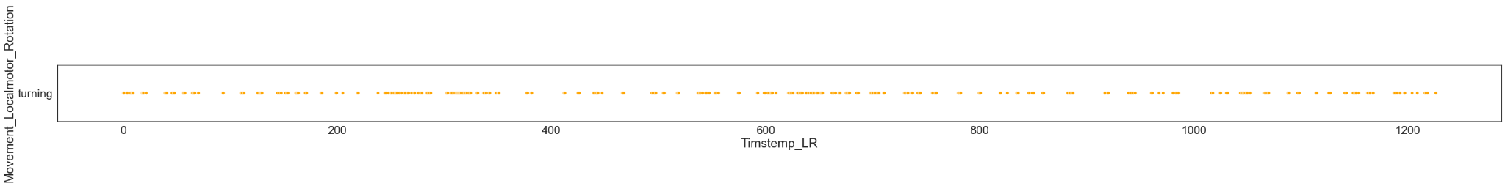
Analysis - Kitchen 3
Goal: Cooking
Locomotor: Rotation
Rotation
Instances Detected: 408
Notes:
30 seconds
Timestamp: 7:30

Slide 18
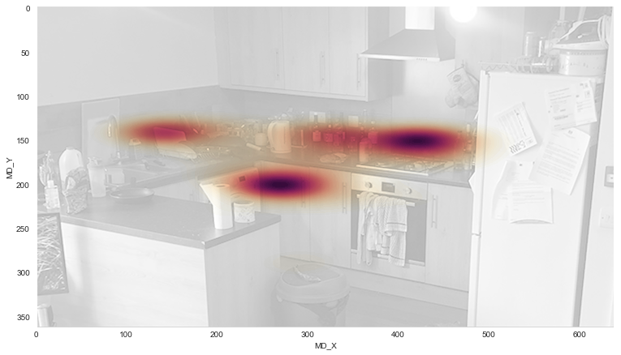
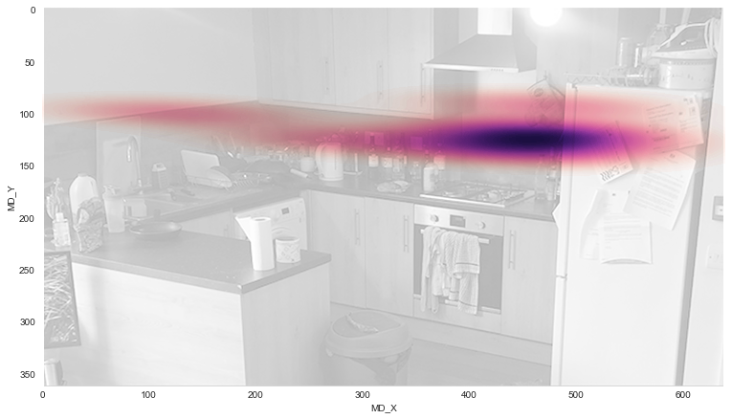
Analysis - Kitchen 3
Goal: Cooking
Non-Locomotor: Bending, Reaching
Bending
Reaching
Instances Detected: 1029
Instances Detected: 52
Notes:
30 seconds
Timestamp: 8:00

Slide 19
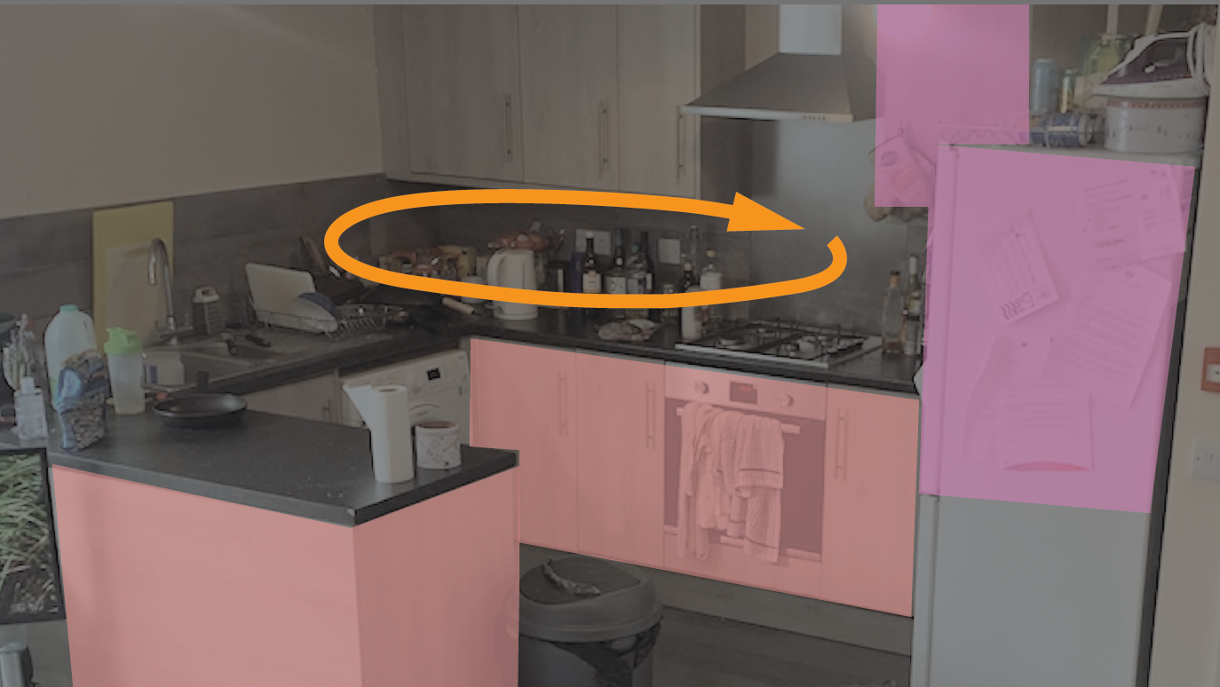
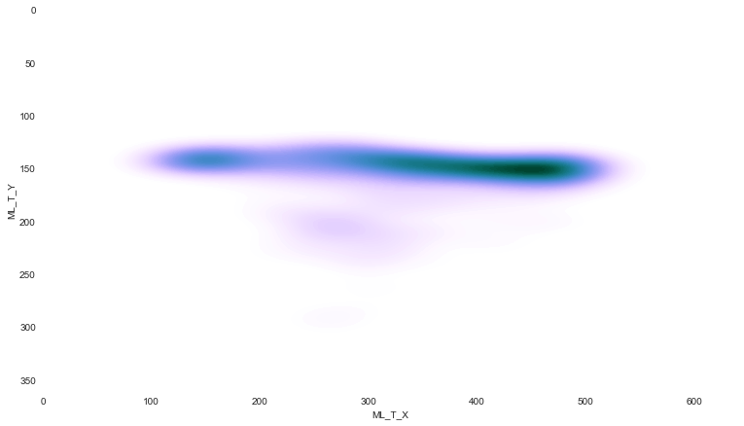
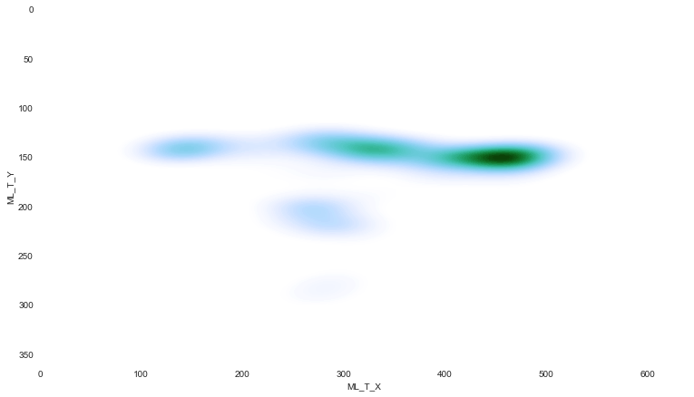
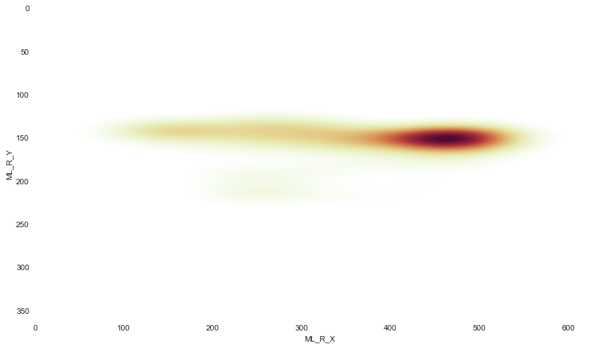
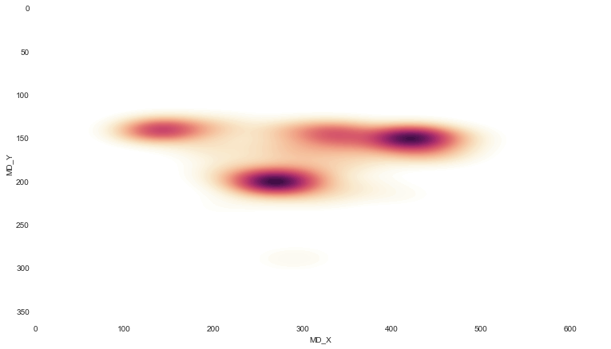
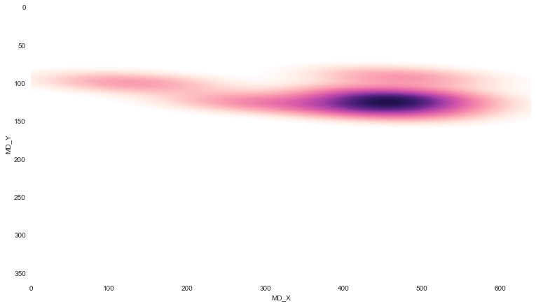
Analysis - Design Suggestions
Eliminate items stored at high location to avoid straining and improve accessibility
Do not place the items used often on the lower drawers.
Create more space for turning or redesign to reduce rotational motion
1.
2.
3.
Notes:
30 seconds
Timestamp: 8:30

Slide 20
Real-time Trial
https://tinyurl.com/elemot
Notes:
30 seconds
Timestamp:12

Slide 21
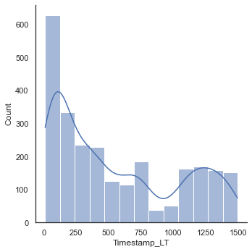

Limitations/Improvements
Limited to single person
Only recording coordinates of shoulder centers
Accuracy dependent on the accuracy of poseNet
PoseNet detection frequency may depend on the computational power
PoseNet seems to lag after 120 seconds, reducing the frequency of pose detection
Accuracy of pose estimation calculation method is yet to be evaluated
Notes:
30 seconds
Timestamp: 11:00

Slide 22
Other Applications
Ergonomics & Behavioral Biometrics - User and product research
Gaming, VR and HCI - enables user to control and command with actions without needing to use a physical interface
Physical Therapy - Detecting changes and improvements in movement injuries
Sports - Motion and Performance analysis for athletes
Robotics - Learning and Response
Ambient Assisted Living - Emergency and fall detection
Autonomous Driver Vision - Pedestrian action detection

Slide 23
THANK YOU!

Slide 24
Appendix

Slide 25




Initial Observations
Notes:
<30 seconds
Timestamp: 3:00

